Slide 1
Chapter 7
Demand Forecasting
Text Book:
William J. Stevenson, Operations Management, 8th ed., McGraw-Hill. Garrison

Slide 2
What is Forecasting?
Process of predicting a future event
Underlying basis of
all business decisions
  Production
  Material Requirement
  Personnel
  Facilities
  Budgeting
Sales will be $200 Million!

Slide 3
Steps in Forecasting Process
Determine the purpose
Establish a time horizon
Select a forecasting technique
Gather and analyze the appropriate data
Prepare the forecast
Monitor the forecast

Slide 4
Types of Forecasts by Time Horizon
Short-range forecast
  Usually less than 3 months
  Job scheduling, worker assignments
Medium-range forecast
  3 months to 3 years
  Sales & production planning, budgeting
Long-range forecast
  3⁺ years
  New product planning, facility location
Notes:
At this point, it may be useful to point out the “time horizons” considered by different industries. For example, some colleges and universities look 30 to fifty years ahead, industries engaged in long distance transportation (steam ship, railroad) or provision of basic power (electrical and gas utilities, etc.) also look far ahead (20 to 100 years). Ask them to give examples of industries having much shorter long-range horizons.

Slide 5
Product Demand Charted over 4 Years with Trend and Seasonality
Seasonal peaks
Trend component
Actual demand line
Demand for product or service
Average demand over four years
Year
1
Year
2
Year
3
Year
4
Notes:
This slide illustrates a typical demand curve. You might ask students why it is important to know more than simply the actual demand over time. Why, for example, would one wish to be able to break out a “seasonality” factor?

Slide 6
Forecasting Approaches
Qualitative Methods
Quantitative Methods
Used when situation is vague & little data exist
  New products
  New technology
Involves intuition, experience
  e.g., First arrival of android phone.
Used when situation is ‘stable’ & historical data exist
  Existing products
  Current technology
Involves mathematical techniques
  e.g., Forecasting demand of Rod of a steel plant
Notes:
This slide distinguishes between Quantitative and Qualitative forecasting. If you accept the argument that the future is one of perpetual, and perhaps significant change, you may wish to ask students to consider whether quantitative forecasting will ever be sufficient in the future - or will we always need to employ qualitative forecasting also. (Consider Tupperware’s ‘jury of executive opinion.’)

Slide 7
Qualitative Methods
Sales force composite
Jury of executive opinion
Delphi method
Consumer Market Survey
Notes:
This slide outlines several qualitative methods of forecasting. Ask students to give examples of occasions when each might be appropriate.
The next several slides elaborate on these qualitative methods.

Slide 8
Sales Force Composite (or grass roots forecasting)
Person closest to customer ends knows best
Combines each levels
Sales representatives know customers’ wants
Manufacturing firms(eg:Abul Khair Steel Melting)
Level0+level1+level2+….+level n=input of top level
Sales
© 1995 Corel Corp.
Notes:
You might ask your students to consider what problems might occur when trying to use this method to predict sales of a potential new product.

Slide 9

Jury of Executive Opinion (or panel consensus)
Involves people from various positions in the organization
  Group estimates demand by working together
Relatively quick
Free exchange of ideas
Lower employee levels
may get intimidated
by higher management.
© 1995 Corel Corp.
Notes:
Ask your students to consider other potential disadvantages. (Politics?)

Slide 10
Delphi Method
Iterative group process. Conceals identity of participants
Moderator makes a questionnaire.
Response are summed and new set of questions are provided
Notes:
You might ask your students to consider whether there are special examples where this technique is required. ( Questions of technology transfer or assessment, for example; or other questions where information from many different disciplines is required.)

Slide 11
Step by step procedure
1.Choose the experts to participate.
2.Through a question set obtain forecasts from the participants.
3.Summarize the results and redistribute them to the participants along with new set of question.
4.Summarize again.
5.Repeat step 4 if necessary and distribute the final result.

Slide 12

Consumer Market Survey (or Market Research)
Ask customers about purchasing plans
What consumers say, and what they actually do are often different
Sometimes difficult to answer
How many hours will you use the Internet next week?
© 1995 Corel Corp.
Notes:
You might discuss some of the difficulties with this technique. Certainly there is the issue that what consumers say is often not what they do. There are other problems such as that consumers sometime wish to please the surveyor; and for unusual, future, products, consumers may have a very imperfect frame of reference within which to consider the question.

Slide 13



Slide 14
Quantitative Approaches
Naïve approach
Moving averages
Exponential smoothing
Trend projection
Linear regression
Time-series Models
Associative models

Slide 15
Naive Approach
Assumes demand in next period is the same as demand in most recent period without adjusting them considering any factor.
  e.g., If May sales were 48, then June sales will be …47/49
Sometimes cost effective & efficient
© 1995 Corel Corp.
Notes:
This slide introduces the naïve approach. Subsequent slides introduce other methodologies.

Slide 16
Moving Average Method
MA is a series of arithmetic means
Used if little or no trend
Used often for smoothing
  Provides overall impression of data over time
Equation
∑
Demand in
Previous
n
Periods
MA
=
n
Notes:
At this point, you might discuss the impact of the number of periods included in the calculation. The more periods you include, the closer you come to the overall average; the fewer, the closer you come to the value in the previous period. What is the tradeoff?

Slide 17
Moving Average Example
You’re manager of a museum store that sells historical replicas. You want to forecast sales (000) for 2003 using a 3-period moving average.
1998 4
1999 6
2000 5
2001 3
2002 7

Slide 18
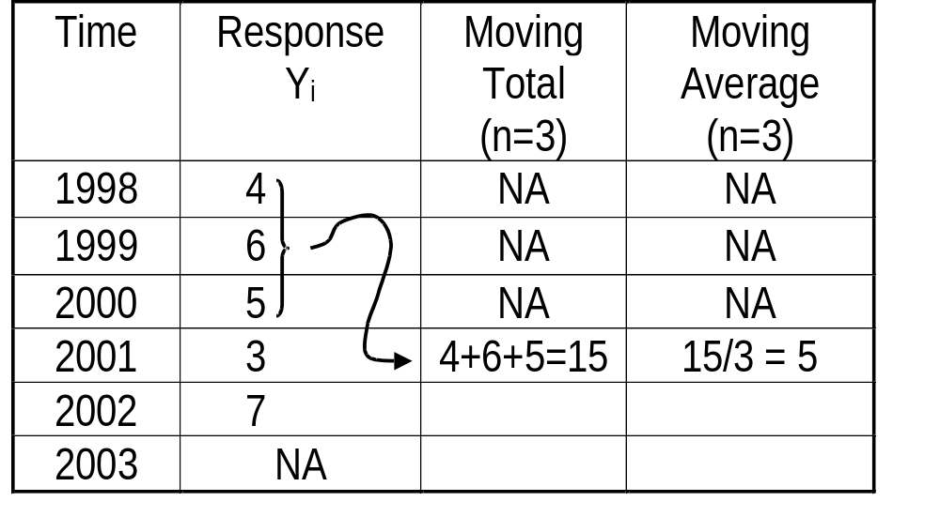
Moving Average Solution

Slide 19
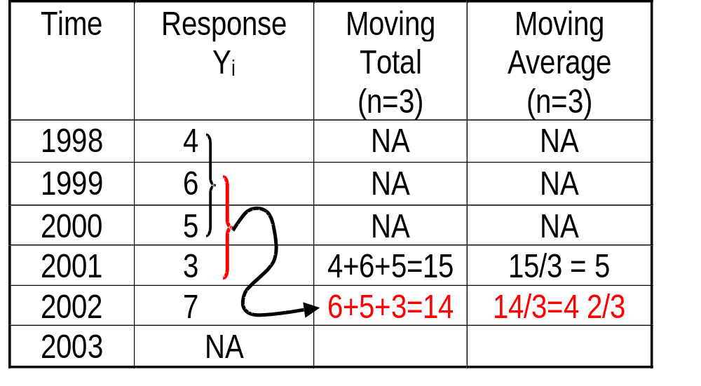
Moving Average Solution

Slide 20
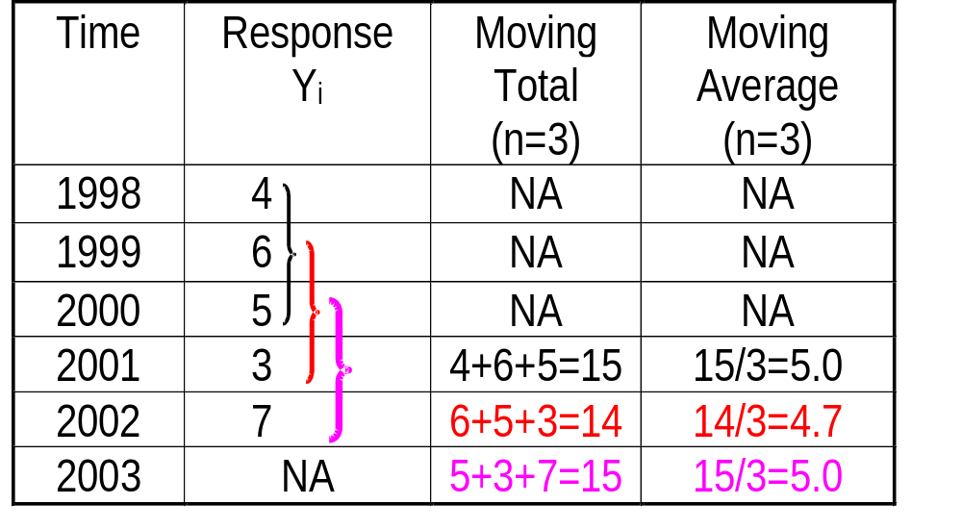
Moving Average Solution

Slide 21

Weighted Moving Average Method
Used when trend is present
  Older data usually less important
Weights based on intuition
  Often lay between 0 & 1, & sum to 1.0
Equation
Notes:
This slide introduces the “weighted moving average” method. It is probably most important to discuss choice of the weights.

Slide 22
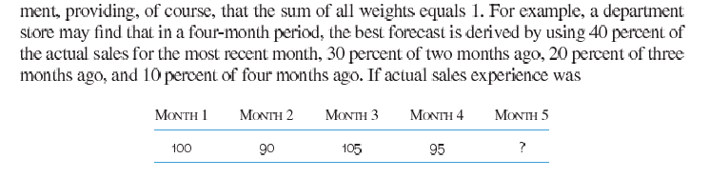
Weighted Moving Average Method
What is the sales forecast for Month 5?
Ans: 97.5 units

Slide 23
Exponential Smoothing Method
Form of weighted moving average
  Weights decline exponentially
  Most recent data weighted most
Requires smoothing constant (α)
  Ranges from 0 to 1
Involves little record keeping of past data
Notes:
This slide introduces the exponential smoothing method of time series forecasting. The following slide contains the equations, and an example follows.

Slide 24
Exponential Smoothing Equations
F_{t} = F_{t-1} + α(A_{t-1} - F_{t-1})
  F_{t} = Forecast value
  A_{t} = Actual value
  α = Smoothing constant
  A_{t-1} - F_{t-1=} Forecast error.
Notes:
You may wish to discuss several points:
- this is just a moving average wherein every point in included in the forecast, but the weights of the points continuously decrease as they extend further back in time.
- the equation actually used to calculate the forecast is convenient for programming on the computer since it requires as data only the actual and forecast values from the previous time point.
- we need a formal process and criteria for choosing the “best” smoothing constant.

Slide 25
Exponential Smoothing Example
During the past 8 quarters, the Port of Mongla has unloaded large quantities of grain. (α = .10). The first quarter forecast was 175..
Quarter Actual
1 180
2 168
3 159
4 175
5 190
6 205
7 180
8 182
9 ?
Find the forecast for the 9th quarter.
Notes:
This slide begins an exponential smoothing example.

Slide 26
Exponential Smoothing Solution
F_{t} = F_{t-1} + α(A_{t-1} - F_{t-1})
Forecast,
F
Quarter
Actual
t
α
(
= .10)
1
180
175.00 (Given)
2
168
175.00 +
3
159
4
175
5
190
6
205

Slide 27
Exponential Smoothing Solution
F_{t} = F_{t-1} + α(A_{t-1} - F_{t-1})
Forecast,
F
Quarter
Actual
t
α
(
= .10)
1
180
175.00 (Given)
2
168
175.00 + .10(
3
159
4
175
5
190
6
205

Slide 28
Exponential Smoothing Solution
F_{t} = F_{t-1} + α(A_{t-1} - F_{t-1})
Forecast,
F
Quarter
Actual
t
α
(
= .10)
1
180
175.00 (Given)
2
168
175.00 + .10(180 -
3
159
4
175
5
190
6
205

Slide 29
Exponential Smoothing Solution
F_{t} = F_{t-1} + α(A_{t-1} - F_{t-1})
Forecast,
F
Quarter
Actual
t
α
(
= .10)
1
180
175.00 (Given)
2
168
175.00 + .10(180 - 175.00)
3
159
4
175
5
190
6
205

Slide 30
Exponential Smoothing Solution
F_{t} = F_{t-1} + α(A_{t-1} - F_{t-1})
Forecast,
F
Quarter
Actual
t
α 
(
= .10)
1
180
175.00 (Given)
2
168
175.00 + .10(180 - 175.00) = 175.50
3
159
4
175
5
190
6
205

Slide 31
Exponential Smoothing Solution
F_{t} = F_{t-1} + α(A_{t-1} - F_{t-1})
Forecast,
F
Quarter
Actual
t
α
(
= .10)
1
180
175.00 (Given)
2
168
175.00 + .10(180 - 175.00) = 175.50
3
159
175.50 + .10(168 - 175.50) = 174.75
4
175
5
190
6
205

Slide 32
Exponential Smoothing Solution
F_{t} = F_{t-1} + α(A_{t-1} - F_{t-1})
Forecast,
F
Time
Actual
t
α
(
= .10)
4
175
174.75 + .10(159 - 174.75) = 173.18
5
190
173.18 + .10(175 - 173.18) = 173.36
6
205
173.36 + .10(190 - 173.36) = 175.02
7
180
175.02 + .10(205 - 175.02) = 178.02
8
182
178.02 + .10(180 - 178.02) = 178.22
9
?
178.22 + .10(182 - 178.22) = 178.58
Notes:
This slide illustrates the result of the steps used to make the forecast desired in the example. In the PowerPoint presentation, there are additional slides to illustrate the individual steps.

Slide 33

Linear Regression
Least Squares Method
Actual observation
Deviation
Deviation
Deviation
Deviation
Point on regression line
Values of Dependent Variable
Deviation
Deviation
Deviation
Time
Notes:
This slide introduces the topic of least squares.
One might try to make the point, using this slide, that the goal of least squares is to minimize the average deviation without regard to the mathematical sign of the deviation. The average of the deviations could be minimized by making their sum equal to zero - but we could still be left with large positive and negative deviations. Minimizing the sum of the square of the deviations produces a more “balanced” set of deviations.

Slide 34
Linear Trend Projection
Used for forecasting linear trend line
Assumes relationship between response variable, Y, and time, X, is a linear function
Estimated by least squares method
  Minimizes sum of squared errors
Y
=
a
+
bX
i
i
Notes:
This slide introduces the equation produced in linear trend progression.

Slide 35
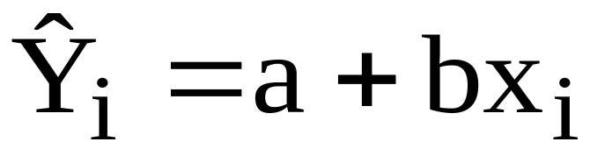
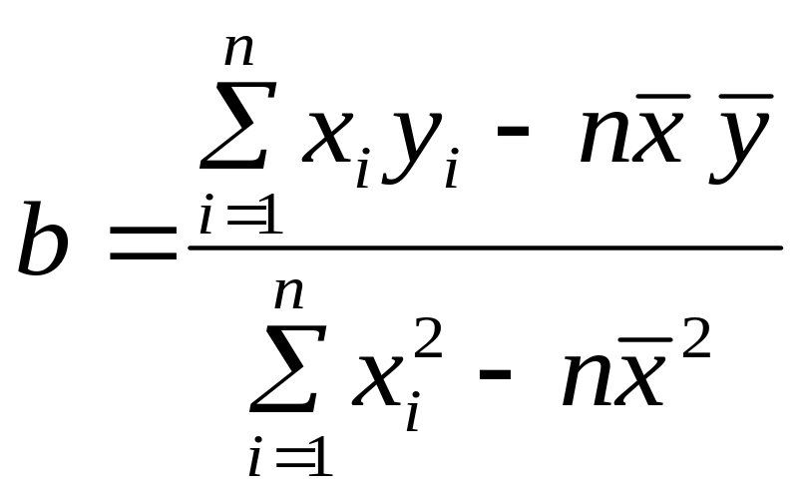
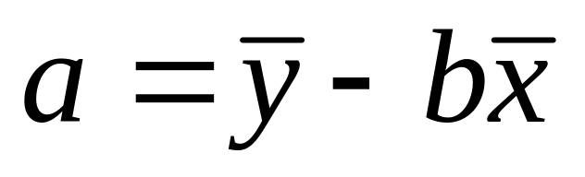
Least Squares Equations
Equation:
Slope:
Y-Intercept:
Notes:
It is probably useful to go through this slide in detail, indicating the differences between the individual values of the variable, and its average.

Slide 36
Using a Trend Line
The demand for electrical power at N. Y. Edison over the years 1997-2003 is given at the left. Find the overall trend. Also find the demand at 2004 and 2005.
Year Demand (MW)
1997 74
1998 79
1999 80
2000 90
2001 105
2002 142
2003 122

Slide 37
Finding a Trend Line
Year | Time Period | Power Demand | x² | xy
1997 | 1 | 74 | 1 | 74
1998 | 2 | 79 | 4 | 158
1999 | 3 | 80 | 9 | 240
2000 | 4 | 90 | 16 | 360
2001 | 5 | 105 | 25 | 525
2002 | 6 | 142 | 36 | 852
2003 | 7 | 122 | 49 | 854
 | Σx=28 | Σy=692 | Σx²=140 | Σxy=3,063

Slide 38
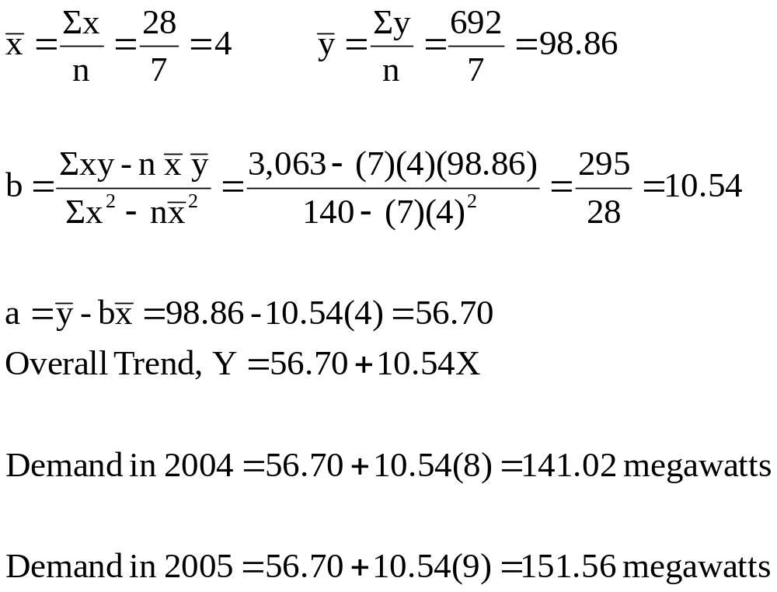
The Trend Line Equation

Slide 39
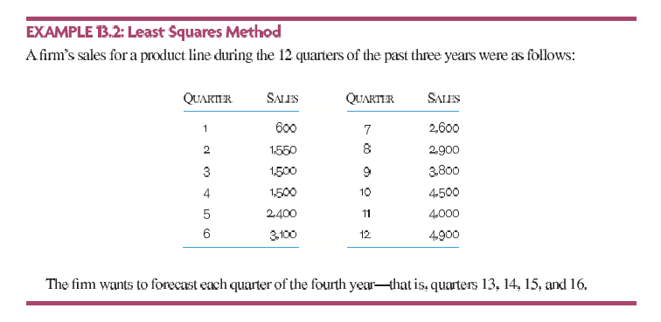
Practice Problem
Ans: Y= 441.6+ 359.6X

Slide 40
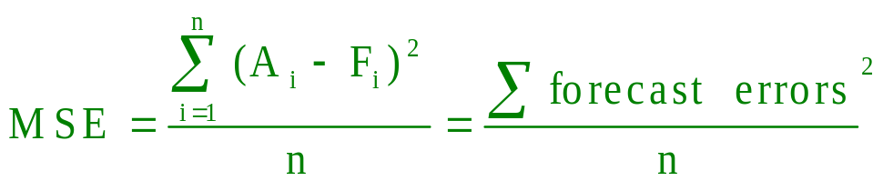
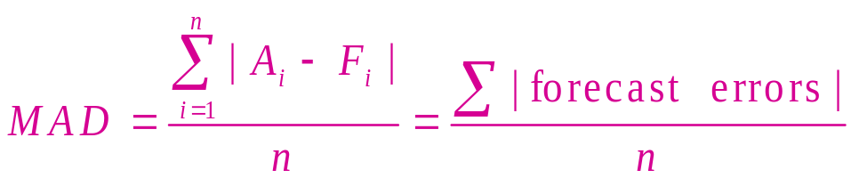
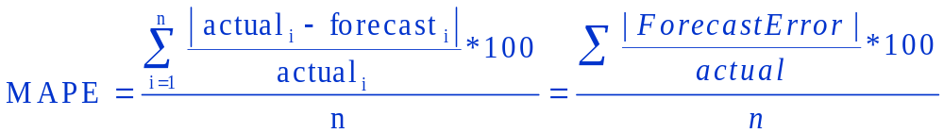
Forecast Error Equations
Mean Square Error (MSE)
Mean Absolute Deviation (MAD)
Mean Absolute Percent Error (MAPE)
Notes:
This slide illustrates the equations for two measures of forecast error. Students might be asked if there is an occasion when one method might be preferred over the other.

Slide 41
Forecast Error Problem
Calculate MAD, MSE and MAPE from the data shown below:
Period | Actual | Forecast
1 | 217 | 215
2 | 213 | 216
3 | 216 | 215
4 | 210 | 214
5 | 213 | 211
6 | 219 | 214
7 | 216 | 217
8 | 212 | 216

Slide 42
Forecast Error Calculation
Period | Actual | Forecast | Error,(A-F) | |Error| | Error^2 | (|Error|/Actual)*100
1 | 217 | 215 | 2 | 2 | 4 | 0.92%
2 | 213 | 216 | -3 | 3 | 9 | 1.41%
3 | 216 | 215 | 1 | 1 | 1 | 0.46%
4 | 210 | 214 | -4 | 4 | 16 | 1.90%
5 | 213 | 211 | 2 | 2 | 4 | 0.94%
6 | 219 | 214 | 5 | 5 | 25 | 2.28%
7 | 216 | 217 | -1 | 1 | 1 | 0.46%
8 | 212 | 216 | -4 | 4 | 16 | 1.89%
MAD= 22/8 = 2.75, MSE = 76/8 = 9.5, MAPE= 10.26%/8 = 1.28%

Slide 43


